Slide 1
Gaussian belief propagation analysing
Viacheslav Naumov, Gleb Mazanov
Skoltech, 2022

Slide 2
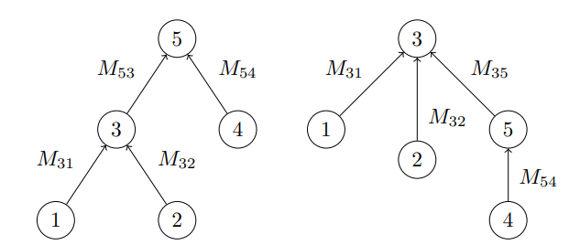
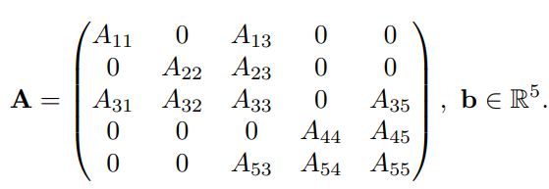
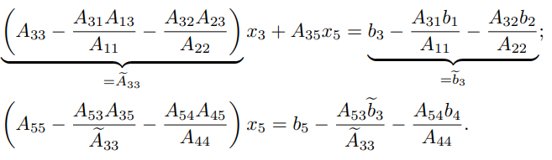
GaBP from the elimination perspective

Slide 3

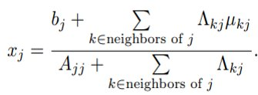
GaBP from the elimination perspective

Slide 4
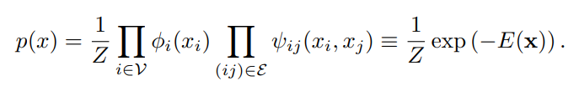
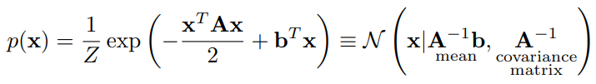

Markov random field

Slide 5
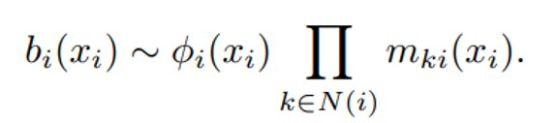
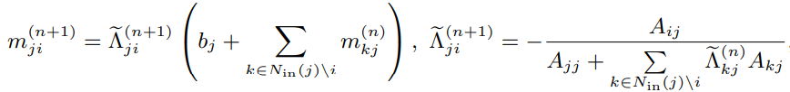
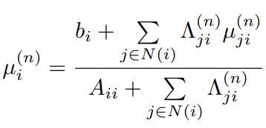
Message updating

Slide 6
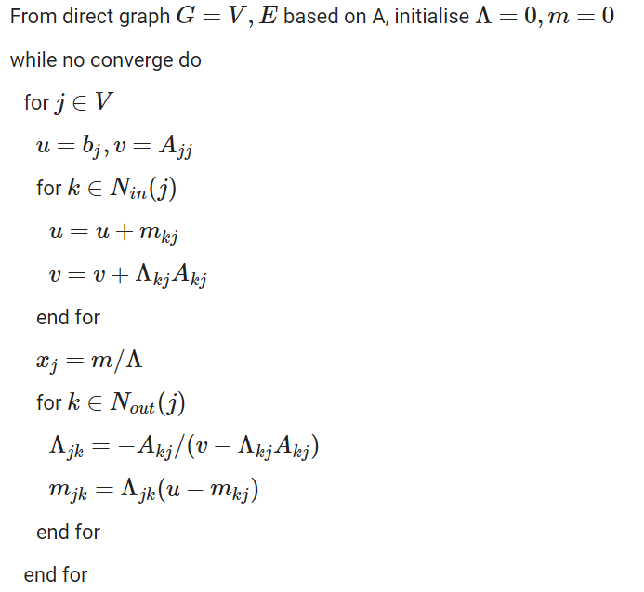

Slide 7


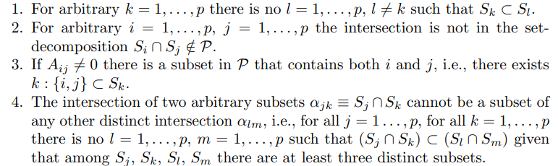
Set-decomposition

Slide 8

Set-decomposition and the region graph

Slide 9


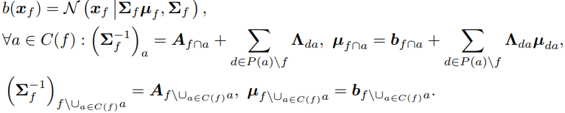
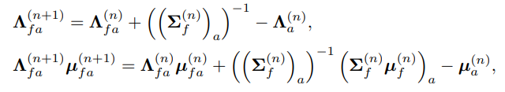
Message update rules
The set a receive message from variables in the set b iff a in b
if a from L_{P}
if f from P

Slide 10





GaBP for a nonsymmetric linear system
Input: A, b, set P
Get region graph R based on A and P, initialize for all e from E_{R}
while not convergence:
for v in V_{R}, C(v) != 0:
m_{v} = b_{v},
for y in P(u)\v:
m_{u} = m_{u} + m_{yu},
for u in C(v):
Out: approximate solution x

Slide 11
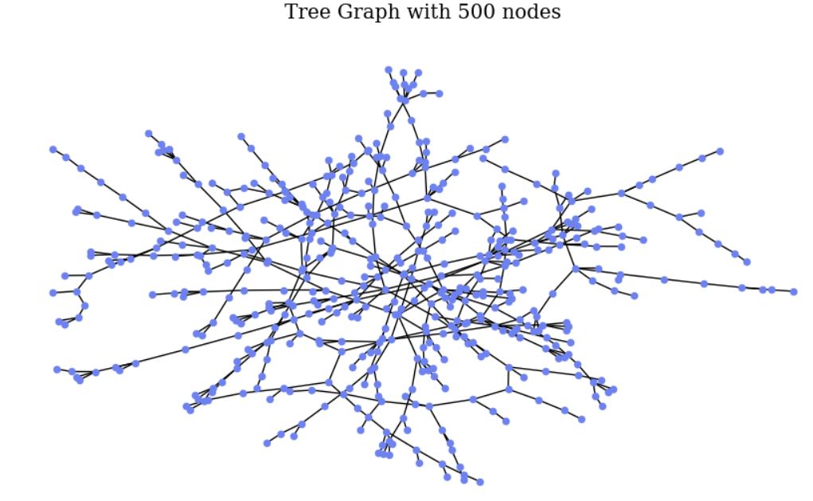
Results of the emplementation

Slide 12
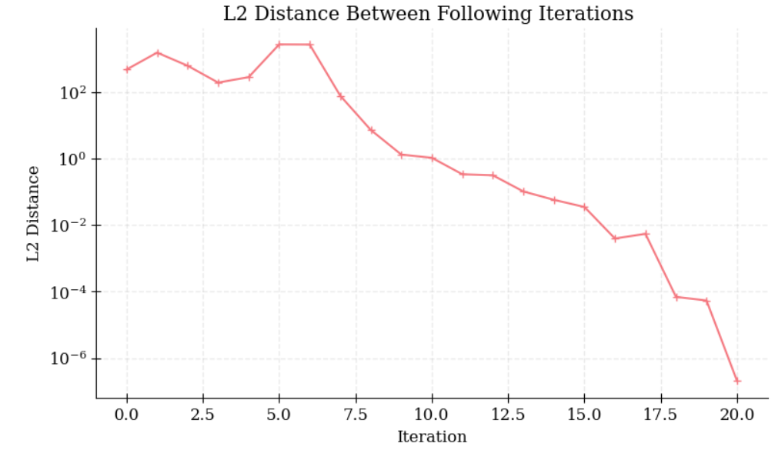
Results of the emplementation

Slide 13
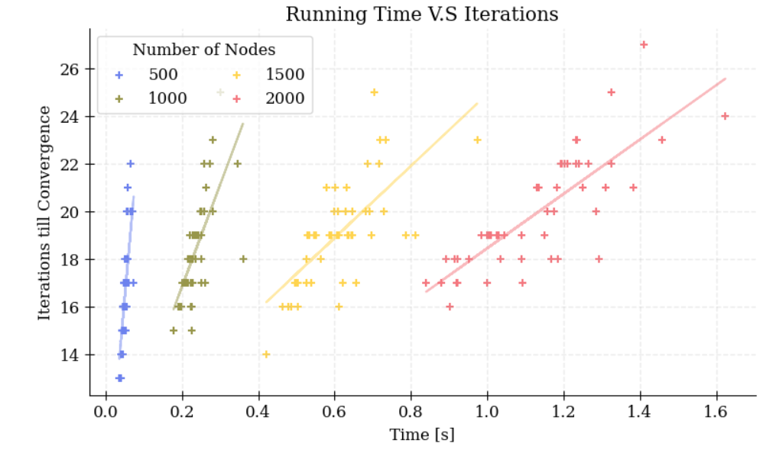
Results of the emplementation

Slide 14
Results of the emplementation
GaBP | GMRES | GMRES (restarts) | BiCG | BiCGSTAB | Gaussian - Seidel
82 ms | 3200 ms | 25 ms | 65 ms | 110 ms | 99 ms
GaBP advantages:
Suitable when there are linked small clusters of variables
Suitable for large grids
GaBP issues:
Can be less efficient because the presence of messages leads to an increased number of floating point operations
Performance depends on the set-decomposition P

Slide 15
Thank you for your attention

